Slide 1
Why do Quants love NAG? a.k.a. NAG for Financial Engineering / Computational Mathematics
John Holden
john.holden@nag.co.uk
John Muddle
john.muddle@nag.co.uk
March 2016
UCL, Financial Computing and Analytics

Slide 2
Agenda
NAG Introduction
NAG and UCL
Why do Quants love NAG?
……..and why you should use NAG
Problems in numerical computation
NAG’s Numerical Libraries, Toolboxes and Tools

Slide 3
NAG Background
Founded 1970
Not-for-profit organisation
Surpluses fund on-going R&D
Mathematical and Statistical Expertise
Numerical Libraries of components
Consulting
HPC Services
Computational Science and Engineering (CSE) support
Procurement advice, market watch, benchmarking
Notes:
Majority of developers in Oxford
World-wide support around the clock

Slide 4
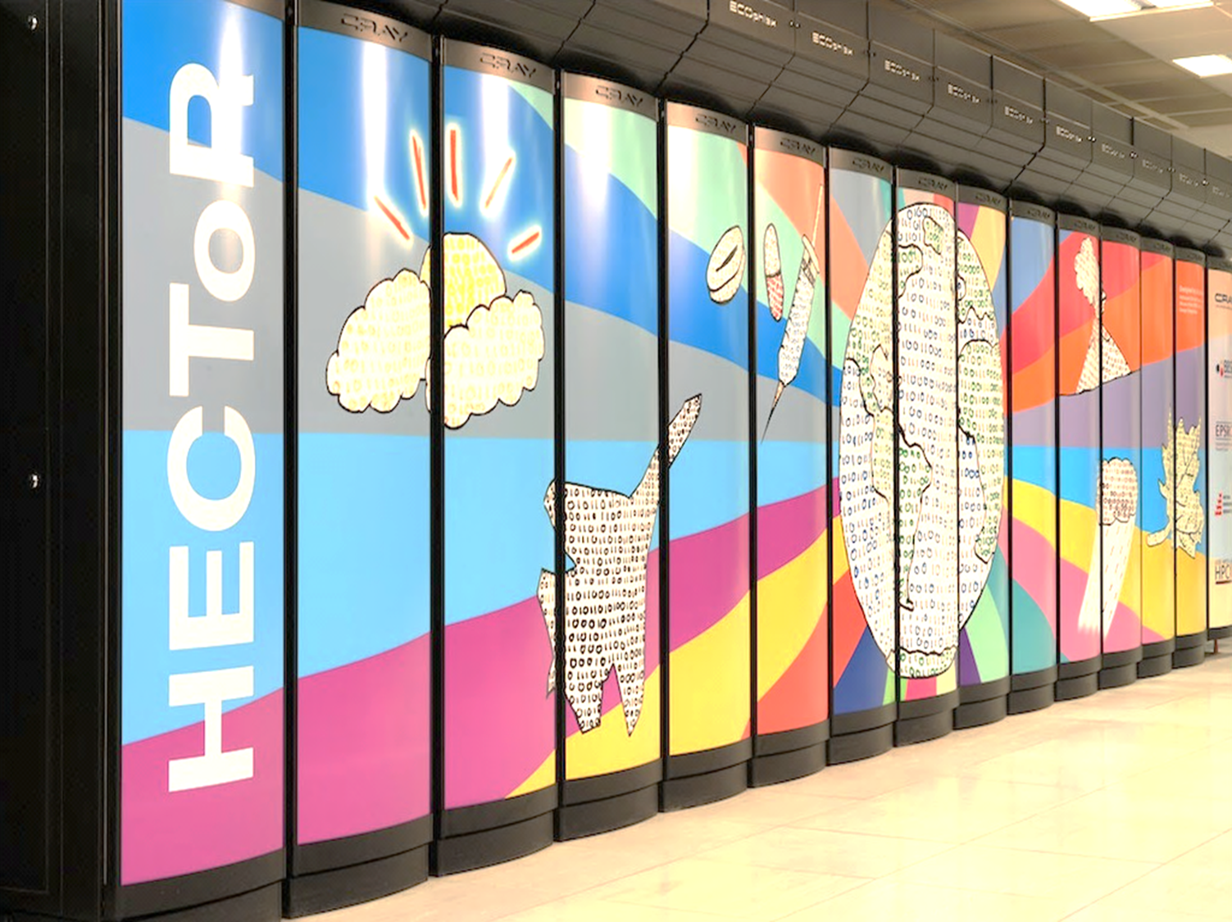






HPC Services
Government, Academic and Commercial
Full CSE service
Code porting, tuning, scaling, rewriting…
Training
1-20 FTEs per annum
Procurement advice/benchmarking
ARM

Slide 5
Portfolio
Numerical Libraries
Highly flexible for use in many computing languages (C, C++, Fortran,…) programming environments, hardware platforms and for high performance computing methods
Products for Excel, MATLAB, Python, .NET, and Java
Giving users of the spreadsheets and mathematical software packages access to NAG’s library of highly optimized and often superior numerical routines
Algorithmic Differentiation tools and services for C/C++, and Fortran (dco)
NAG Fortran Compiler and GUI based Windows Compiler: Fortran Builder
HPC Training and Consultancy services

Slide 6
University Site Licence
Unlimited use of all NAG products
On Windows, Linux and Mac o/s
As long as for academic or research purposes
Installation may be on any university, staff or student machine
Full access to NAG Support support@nag.co.uk
Request support or licence keys using your university e-mail address @ucl.ac.uk
Our software:
Includes online documentation - also www.nag.co.uk
Supplied with extensive example programs
data and results

Slide 7



NAG and UCL collaboration
Performance improvements to Quantum Monte-Carlo code (CASINO) – working with Dario Alfe, Earth Sciences under HECToR
GPU accelerated pivoted QR decomposition algo with BEM++ group - Tim Betcke et al, Maths
Thomas Luu, 'Fast and accurate parallel computation of quantile functions for random number generation' (supervised by William Shaw, Maths)
Long time partner for Financial Computing & Analytics CDT
and most recently with Eikon Appathon
HPC and product training available
New student projects and placements possible

Slide 8
Agenda
NAG Introduction
NAG and your University
Why do Quants love NAG?
Problems in numerical computation
NAG’s Numerical Libraries and Toolboxes
NAG student prizes and jobs

Slide 9
Why bother?
Numerical computation is difficult to do accurately
Problems of
Overflow / underflow
How does the computation behave for large / small numbers?
Condition
How is it affected by small changes in the input?
Stability
How sensitive is the computation to rounding errors?
Importance of
error analysis
information about error bounds on solution

Slide 10
Why Quants use NAG Libraries and Toolboxes?
Global reputation for quality – accuracy, reliability and robustness…
Extensively tested, supported and maintained code
Reduces development time
Allows concentration on your key areas
Components
Fit into your environment
Simple interfaces to your favourite packages
Regular performance improvements!
Give “qualified error” messages e.g. tolerances of answers
Notes:
I can provide quotations for NAG users and industry watchers which basically say NAG IS the standard. We have 3,000+ sites worldwide – any think from a single user to a corporate license.
Internal testing/QA is very substantial – more importantly used by sites world-wide.
Maintenance of code is a strong argument for using off-the-shelf solutions – we all know that – a high turnover of staff obviously exacerbates that argument. High turnover of staff means trouble with maintenance or re-writes
NAG has a low staff turnover, but we also restrict ourselves to strict coding standards and a ‘keep it simple’ approach. We’ve all coded something which a month later we didn’t understand! Use NAG code wherever possible to minimise your maintenance burden. And of course that extends to full solutions…
Time: code already written, tested, documented etc; time is money, but also re-write avoidance; will it work - regulatory approval
Add value in your particular areas of expertise – this is inevitably the best return
NAG quality – but what about performance… - many head to head tests have shown our performance to also be great – we work with all the major hardware vendors to ensure that we take advantage of low-level performance improvements. Let’s look at an area where NAG are the world-leaders for performance – even after significant efforts by the vendors to do better…

Slide 11
Why you should use NAG?
Site licence @ UCL
Free for staff and students
You can install on your personal machines
Widely used in Industry
Robust, reliable, accurate, fast and well tested
Full access to NAG technical support team via support@nag.co.uk
But, we won’t do your student assignments for you ;-)!
Notes:
I can provide quotations for NAG users and industry watchers which basically say NAG IS the standard. We have 3,000+ sites worldwide – any think from a single user to a corporate license.
Internal testing/QA is very substantial – more importantly used by sites world-wide.
Maintenance of code is a strong argument for using off-the-shelf solutions – we all know that – a high turnover of staff obviously exacerbates that argument. High turnover of staff means trouble with maintenance or re-writes
NAG has a low staff turnover, but we also restrict ourselves to strict coding standards and a ‘keep it simple’ approach. We’ve all coded something which a month later we didn’t understand! Use NAG code wherever possible to minimise your maintenance burden. And of course that extends to full solutions…
Time: code already written, tested, documented etc; time is money, but also re-write avoidance; will it work - regulatory approval
Add value in your particular areas of expertise – this is inevitably the best return
NAG quality – but what about performance… - many head to head tests have shown our performance to also be great – we work with all the major hardware vendors to ensure that we take advantage of low-level performance improvements. Let’s look at an area where NAG are the world-leaders for performance – even after significant efforts by the vendors to do better…

Slide 12
NAG Financial Maths Student Prizes
THE PRIZE: “Free attendance of finance conference including contribution to flights and accommodation”
THE REQUIREMENT:
Good financial math “project” using NAG software
Submit a description of the project, its goals and the use of NAG software
Winning projects featured on NAG website

Slide 13
How to enter
Write to : nagmarketing@nag.co.uk
As sponsors of a wide variety of Mathematical Finance conferences and events we are currently able to offer the following choice of prizes:
Global Derivatives, Trading & Risk Management
Budapest, Hungary 2016
Other prizes will be announced as conference tickets are secured.

Slide 14
An example: sample variance
For a collection of observations the mean is defined as and the variance as

Slide 15
Example calculation
For this collection of observations the mean is and the variance is
<Excel – variance demo>

Slide 16
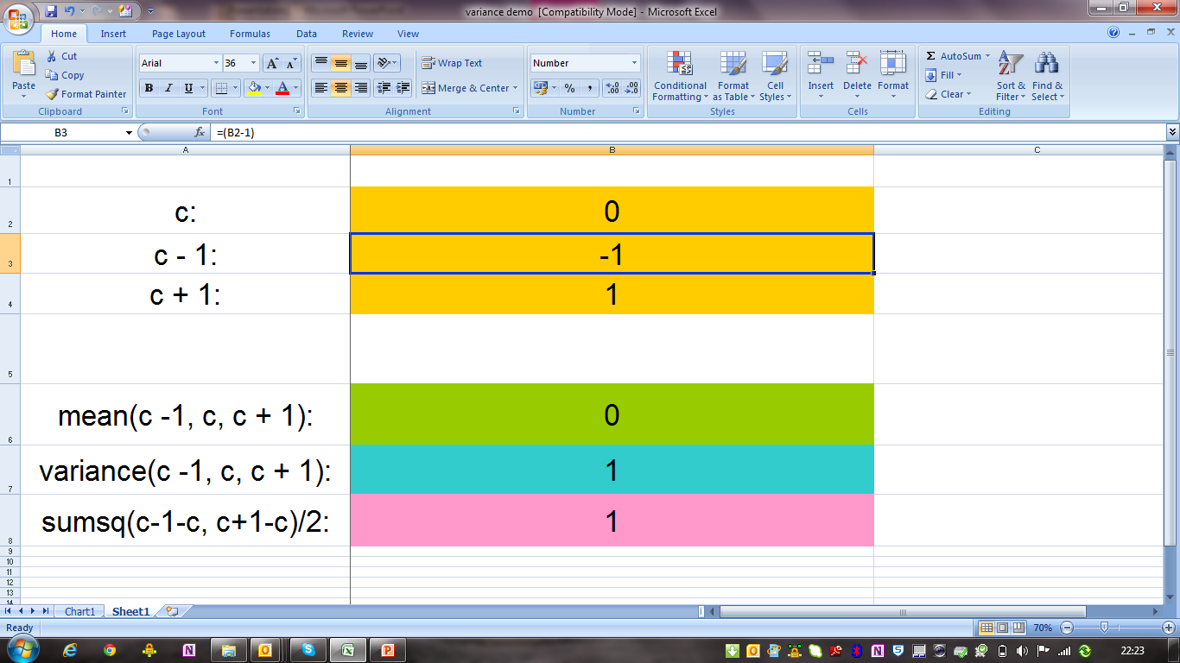

Slide 17
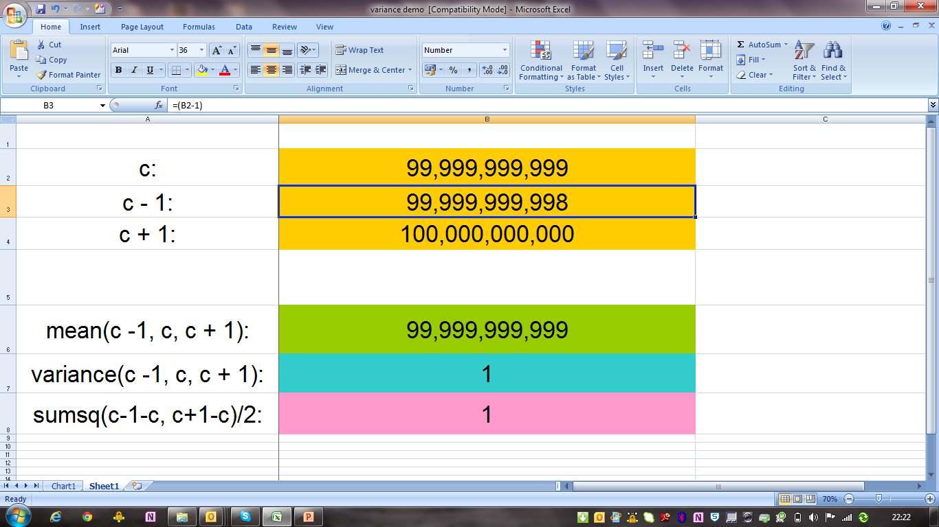

Slide 18
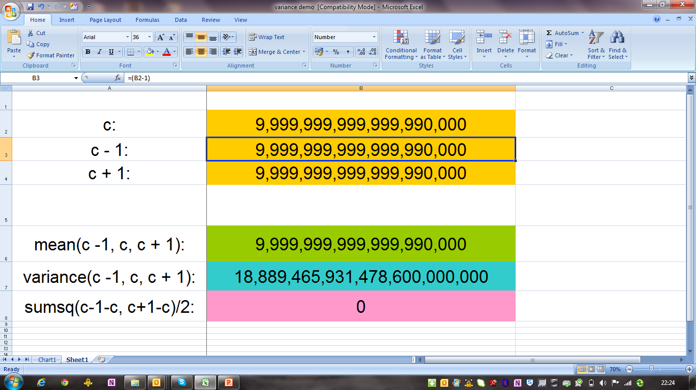

Slide 19


Slide 20
What’s gone wrong?
Instead of
Excel uses an (analytically identical) formula
faster to calculate (one pass)
accuracy problems if variance is small compared to x

Slide 21
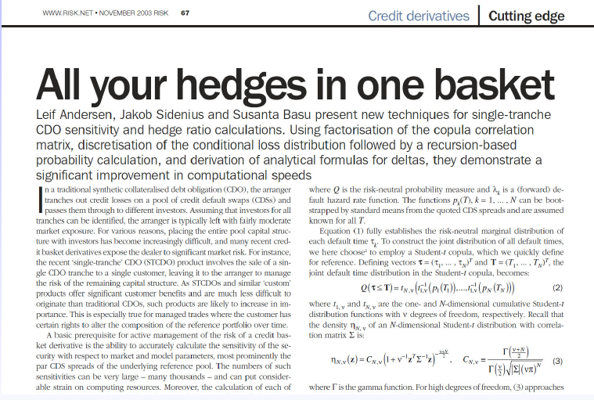
from Finance - k Factor Problem
Notes:
I can provide quotations for NAG users and industry watchers which basically say NAG IS the standard. We have 3,000+ sites worldwide – any think from a single user to a corporate license.
Internal testing/QA is very substantial – more importantly used by sites world-wide.
Maintenance of code is a strong argument for using off-the-shelf solutions – we all know that – a high turnover of staff obviously exacerbates that argument. High turnover of staff means trouble with maintenance or re-writes
NAG has a low staff turnover, but we also restrict ourselves to strict coding standards and a ‘keep it simple’ approach. We’ve all coded something which a month later we didn’t understand! Use NAG code wherever possible to minimise your maintenance burden. And of course that extends to full solutions…
Time: code already written, tested, documented etc; time is money, but also re-write avoidance; will it work - regulatory approval
Add value in your particular areas of expertise – this is inevitably the best return
NAG quality – but what about performance… - many head to head tests have shown our performance to also be great – we work with all the major hardware vendors to ensure that we take advantage of low-level performance improvements. Let’s look at an area where NAG are the world-leaders for performance – even after significant efforts by the vendors to do better…

Slide 22
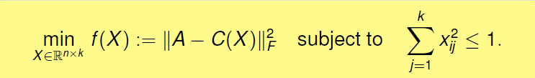
from Finance - k Factor Problem
Principal Factors method (Andersen et al., 2003) does NOT always converge to correct answer… (no convergence theory)
Should have come to NAG….
Our* spectral projected gradient method respects constraints, exploits convexity, converges to a feasible stationary point
*NAG Library G02AE - Borsdorf, Higham & Raydan, 2010,

Slide 23
Numerical computation – DIY Vs NAG
DIY implementations of numerical components have their place, but NOT in production code.
Handwritten and “hand me down” type code might be easy to implement, but it will…
NOT be well tested
NOT fast
NOT stable
NOT deliver good error handling
NAG implementations in contrast are fast and
Accurate
Well tested
Thoroughly documented
Give “qualified error” messages e.g. tolerances of answers (which the user can choose to ignore, but avoids proceeding blindly)
Notes:
and numerical recipe / open source

Slide 24
NAG provides the atomic bricks
… for the quants to build the walls, houses and fancy castles!
Users know NAG Components are here today, tomorrow and beyond
Functions are not removed when new ones added without sensible notice and advice
NAG functions are well documented
Lets take a look….

Slide 25
NAG Library and Toolbox Contents
Root Finding
Summation of Series
Quadrature
Ordinary Differential Equations
Partial Differential Equations
Numerical Differentiation
Integral Equations
Mesh Generation
Interpolation
Curve and Surface Fitting
Optimization
Approximations of Special Functions
Dense Linear Algebra
Sparse Linear Algebra
Correlation & Regression Analysis
Multivariate Methods
Analysis of Variance
Random Number Generators
Univariate Estimation
Nonparametric Statistics
Smoothing in Statistics
Contingency Table Analysis
Survival Analysis
Time Series Analysis
Operations Research
Notes:
No need to pick anything out in particular

Slide 26
Use of NAG Software in Finance
Portfolio analysis / Index tracking / Risk management
Optimization, linear algebra, copulas…
Derivative pricing
PDEs, RNGs, multivariate normal, …
Fixed Income/ Asset management / Portfolio Immunization
Operations research
Data analysis
Time series, GARCH, principal component analysis, data smoothing, …
Monte Carlo simulation
RNGs
……

Slide 27
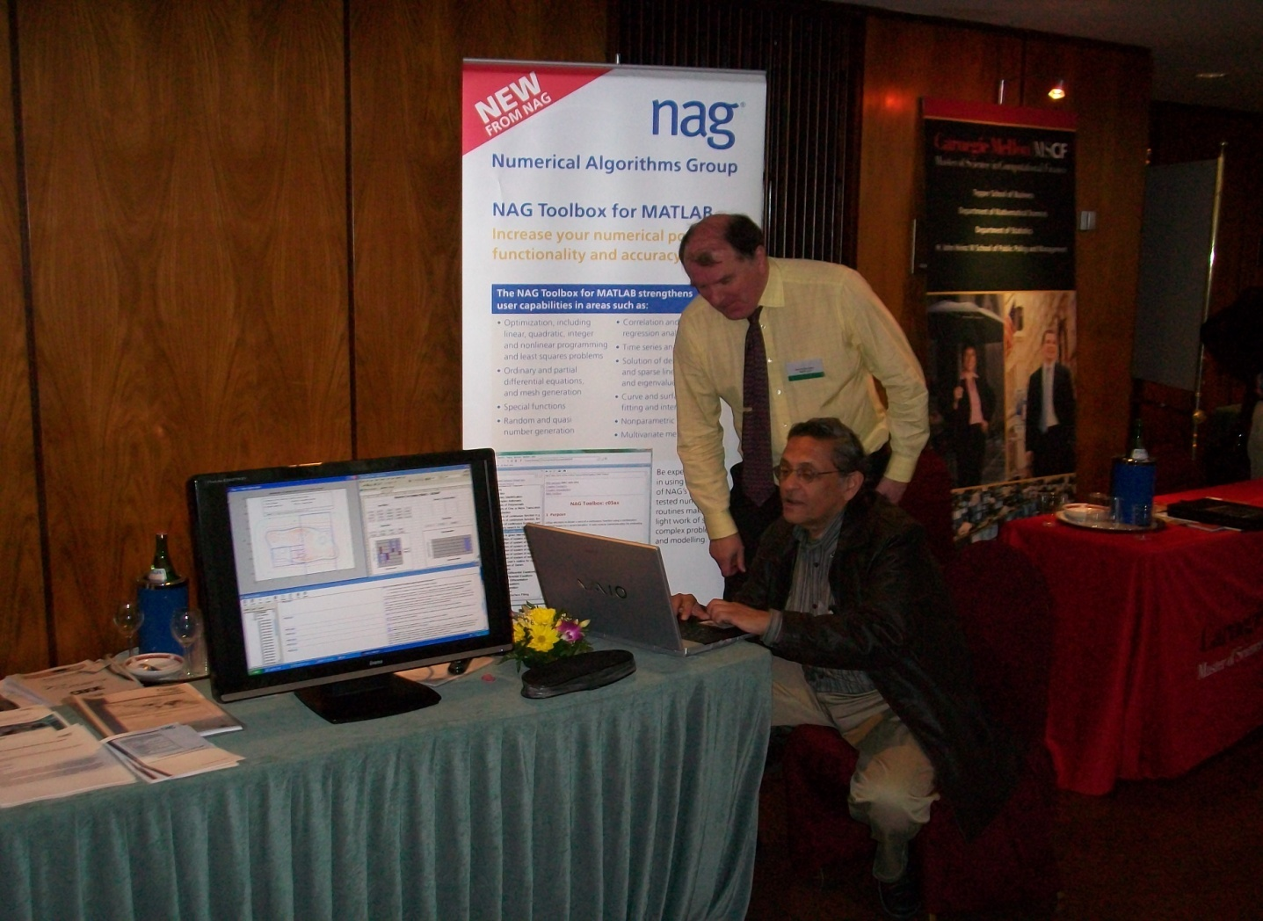
Don’t take our word for it….
Financial Maths Professor and Morgan Stanley consultant speeds up his optimization
Notes:
M in CGMY model related Levy processes

Slide 28
Why an Exotics Options Quant loves NAG?
General Problem
To build solvers for a variety of sophisticated financial models in a timely manner that are
robust,
stable,
quick
Solution
Use robust, well tested, fast numerical components and tools
This allows the “expensive” quants to concentrate on the sophisticated models
avoiding distraction with low level numerical components
Notes:
Note: exotic option -> path dependent, often Monte Carlo simulation so likely using RNGs (pseudo and quasi), also PDEs when in 1-4 dimensions, but NAG PDE solvers are difficult to use in this context in their present form.
Problem 1
Build robust, stable PDE solvers for Option Pricing
Solution
Top level items appear like this
Second level items appear like this
Third level items appear like this

Slide 29
Problem 1: Finance PDE Solvers
Major banks PDE solvers tend to be “proprietary” so there is a reluctance to take “end to end” solutions
Several different numerical components needed
Sparse Linear Solvers
Functions for finding a range of Eigenvalues (stability checkers)
Special Linear Systems solvers (e.g. Banded Matrices)
..

Slide 30
Problem 1: Finance PDE Solvers
Major banks PDE solvers tend to be “proprietary” so there is a reluctance to take “end to end” solutions
NAG to the rescue
Several different numerical components needed
Sparse Linear Solvers √
Functions for finding a range of Eigenvalues (stability checkers) √
Special Linear Systems solvers (e.g. Banded Matrices) √
.. √ √
Notes:
** important to emphasise the use of the Eigen Values & Eigen vectors to confirm stability ** (even historic case of american rocket missed it’s target because calculatoins not right – equations were correct, but because of small drift “random error”
By using and eigen values / eigen vector you can detect this error and then can deduce which variable (i.e. that variable be not quite right) contributing to this error
had samll drift and caused it to be off target) – check story – few years ago

Slide 31
Problem 2: Calibration
Major banks all need to calibrate their models
Several different numerical components needed
Optimisation functions (e.g. constrained non-linear optimisers)
Interpolation functions
Spline functions
..
Notes:
Curve and surface routines = curve & surface

Slide 32
Problem 2: Calibration
Major banks all need to calibrate their models
NAG to the rescue
Several different numerical components needed
Optimisation functions (e.g. constrained non-linear optimisers) √
Interpolation functions (used intelligently*) √
Spline functions √
.. √ √
*interpolator must be used carefully –must know the properties to pick appropriate method
Notes:
In fixed income - the curvature can be very sensitive to knot adjustment especially for longer tenure (careful not to create false convexity in the curver)

Slide 33
Problem 3: Why Adjoints?
Notes:
Top line is without AD
Lower two line are with AD (what is difference?)

Slide 34
3 Computing derivatives in finance is important…
Calculating a product’s sensitivities to a range of risk factors (a.k.a. Greeks) creates huge computational demand on risk and price models
Traditional approach “bumping” - finite differences
Which is Computationally very expensive.. more hardware!
The alternatives to finite differences are
Write derivative code by hand
Efficient, but difficult to write & highly error prone (need to develop original and adjoint models)
Algorithmic Differentiation
flexible and just develop the original model - obvious choice
Notes:
34
“Ark-hun” University (“Oo-va” Naumann)
What is AD in a sentence?
Needs to involve consultancy
Reengineering of application required

Slide 35
Problem 3: Why Adjoints
Option pricing example from
Adjoint Algorithmic Differentiation Tool Support for Typical Numerical Patterns in Computational Finance Naumann & Du Toit
finite difference method on 1,000 x 360 grid
wanted gradient of size n = 222
running on standard PC with 4GB of RAM
Delivering robust and efficient gradient code
 | Primal | Central FD | naïve AAD | robust AAD
run time (sec.) | 0.5 | 175 | ∞ | 6

Slide 36
NAG fits into your favourite environments
Supporting Wide Range of Operating systems…
Windows, Linux, Solaris, Mac, …
…and a number of interfaces
C, C++,
Fortran,
VB, Excel & VBA,
C#, F#, VB.NET,
CUDA, OpenCL,
Hadoop & Apache SPARK
Java, Python
…
Excel,
LabVIEW,
MATLAB,
Maple,
Mathematica
R, S-Plus,
Scilab, Octave
…

Slide 37
NAG Code Examples
Calling NAG from:
Excel – NAG Fortran Library
Python – NAG4PY Wrapper
MATLAB – NAG Toolbox for MATLAB
Examples @
github.com/numericalalgorithmsgroup
Blog.nag.com
nag.co.uk/numeric/nagandexcel-examples

Slide 38

NAG Contacts / Keep in touch
http://www.nag.co.uk/edu/uk/ucl
Technical Support and Help
support@nag.co.uk
Your account manager
john.muddle@nag.co.uk
NAGNews
http://www.nag.co.uk/NAGNews/Index.asp

